Slide 1
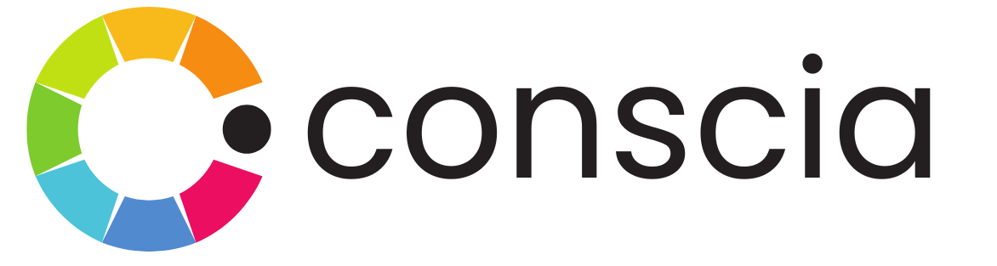
The API and Data Foundation for Agentic Commerce
PROJECT KICK-OFF · APRIL 8, 2026
Conscia: Beyond Traditional PIM
A governed semantic foundation and real-time orchestration engine for complex, configurable commerce
POWERED BY: DX GRAPH + DX ENGINE
Conscia × Lovesac Joint Kick-off

Slide 2
Today's Agenda
01
Problem Statement — Recap of the challenges we’re here to solve
02
Meet the Teams — Introductions and roles
03
Conscia Platform Overview — How DX Graph and DX Engine address Lovesac’s needs
04
Proposed Architecture — Where Conscia sits within your existing stack
05
Data Model Deep-Dive — Collections, hierarchies, taxonomies and relationships
06
Early Findings from Your Data — Initial analysis from the pre-kickoff review
07
Scope & Timeline — Phase 1 scope and implementation plan
08
Success Metrics & Ways of Working — How we’ll measure success and run the project
09
Open Questions & Next Steps — Items to resolve and agreed actions
Lovesac × Conscia · Project Kick-off · April 8, 2026

Slide 3
01 · PROBLEM STATEMENT
No Single Source of Truth for the Product Catalog
You can’t Ask “What goes with this Sactional cover?”
01
Compatibility rules live only inside Threekit. No system can query them programmatically — so every channel has to hard-code logic or send the customer back to the web configurator.
You can’t Serve product data to AgentForce or ChatGPT
02
AI agents need a queryable API. Threekit has no MCP endpoint. Any agentic commerce experience requires custom middleware that duplicates and quickly drifts from the source of truth.
You can’t Keep pricing and inventory in sync across channels
03
NetSuite is the master for both pricing and inventory, but neither feeds the Threekit configurator in real time. Associates and customers frequently see conflicting data depending on which touchpoint they use.
You can’t Launch a new sales channel without rebuilding logic
04
Each new touchpoint (kiosk, app, Google Shopping) requires its own integration. There is no shared experience API — so every channel launch restarts the engineering effort from scratch.
You can’t Understand how customers actually configure products
05
Configuration session data is trapped inside Threekit. There is no way to extract patterns — which cover combinations are popular, where customers drop off, what drives conversion.
Lovesac × Conscia · Project Kick-off · April 8, 2026

Slide 4
01 · PROBLEM STATEMENT
The Bottleneck
DATA SOURCES
CHANNELS
NetSuite ERP
inventory & pricing
Adobe Commerce
Product Catalogue
Compatibility rules locked inside.
No external API.
Salesforce Retail Cloud
▶
X
Problem: Compatibility intelligence is locked in one tool, and no downstream channel can query it directly.
(See Appendix for more detail)
X
Manhattan Active Omni
Threekit
Visual Configurator
Lovesac.com
▶
X
Google Shopping
Product Team
manual updates
X
AgentForce / ChatGPT
▶
Lovesac × Conscia · Project Kick-off · April 8, 2026

Slide 5
02 · MEET THE TEAMS
Meet the Teams
Conscia
Lovesac
M
Morgan · Project Manager
morgan@conscia.ai
A
Amelia Jacobs · VP, Customer Experience & IT
ameliajacobs@lovesac.com
S
Sana · Product Owner
sana@conscia.ai
T
Tate Swanson · Sr. Domain Data Architect
tateswanson@lovesac.com
L
Laurel · Sr. Solution Engineer
laurel@conscia.ai
D
David · Solution Architect
david@conscia.services
Lovesac × Conscia · Project Kick-off · April 8, 2026

Slide 6
03 · CONSCIA PLATFORM OVERVIEW
Conscia Platform Overview
01 · DX GRAPH
02 · DX ENGINE
03 · EXPERIENCE APIs
Semantic* Foundation
Orchestration Engine
Experience APIs
Single SKU Collection unifying all brands, lines, and component roles
Dynamic Relationships: COMPATIBLE_WITH, BUNDLES, CONTAINS, MAPS_TO
Up to 3 parallel Taxonomy Collections via MAPS_TO
Version-controlled, governed product data
Real-time orchestration of business rules across channels
Channel-aware Experience Rules (e.g. Outdoor restrictions, Quickship eligibility)
Deterministic logic + AI-assisted decisioning where it adds value
Zero-code configuration through Conscia UI
One Experience API serving POS, web, mobile, agents, and feeds
Sub-second responses at the edge
Native MCP endpoint — agent-ready by design
No frontend glue code; no per-channel reimplementation
One model. One source of truth.
Rules in one place — not duplicated per channel.
New channels go live in days, not quarters.
*A semantic model stores facts and the meaningful connections between them: a Cover belongs to the 6 Series, is compatible with these Inserts, is part of these Bundles, maps to multiple channel taxonomies. Relationships are first-class, not query-time joins.
Lovesac × Conscia · Project Kick-off · April 8, 2026
Notes:
Semantic here means "based on meaning and relationships" rather than "based on rows and columns".
A traditional product database stores facts: SKU 12345 has fabric "Charcoal Chenille", price $199, weight 14 lbs.
A semantic model stores facts plus the meaningful connections between them: SKU 12345 is a Cover, belongs to the 6 Series, is compatible with these 47 Inserts, is part of these 12 finished-good Bundles, maps to "Living Room > Sofas > Sectionals" in the Lovesac.com taxonomy and "Home & Garden > Furniture > Sofas" in the Google Shopping taxonomy. The relationships are first-class citizens, not joins you have to figure out at query time.

Slide 7
04 · PROPOSED ARCHITECTURE
Proposed Architecture Fit
Two complementary platform capabilities that together make Conscia the governed product master for Lovesac.
DX GRAPH
DX ENGINE
Governed Product Data Layer
Real-Time Orchestration Layer
"What is true?"
"What should happen?"
Unified SKU Collection — Sactional, Sac, Snugg, and Accessories — ~13,700 SKUs in one model
Cover ↔ Insert compatibility encoded as a Dynamic Relationship (no manual tagging — covers all ~10,800 Cover SKUs automatically)
Up to 3 parallel Taxonomies — internal ops, Lovesac.com, and marketplace feeds
Version-controlled and audit-ready
Config Validation — does this combination obey all the rules?
Wizard-Step Options — what can the customer pick next, given what they've already chosen?
Config ID Creation — durable identifier for a saved configuration
BOM Explosion — turn a finished good into shippable components, shaped per channel (POS / OMS / warehouse pick list)
One Experience API serving POS, web, agents, and feeds
Lovesac × Conscia · Project Kick-off · April 8, 2026

Slide 8
04 · PROPOSED ARCHITECTURE
End-to-End Architecture
SOURCE SYSTEMS
INTEGRATION HUB
CONSCIA PLATFORM
BACKENDS
CHANNELS & AGENTS
NetSuite
ERP
Financial master for pricing, cost & SKU lifecycle. Source of record for commercial attributes.
Celigo
INTEGRATION PLATFORM
Connects NetSuite, Adobe Commerce, Manhattan Active Omni & Conscia Layer via scheduled and event-driven flows.
DX Graph
GOVERNED PRODUCT MASTER
Semantic data layer & system of record for configurable products. Holds unified SKU collection, compatibility relationships, taxonomy hierarchies & governed entities.
Manhattan Active Omni (MAO)
OMS
Order master; receives exploded BOMs from DX Engine for fulfilment.
POS Terminals
IN-STORE
Lovesac.com
WEB
Adobe Commerce
ECOMMERCE
Web-facing product content, merchandising & storefront metadata.
Lovesac.com
STOREFRONT
Adobe Commerce; consumes validated Config IDs via Experience API.
Mobile Apps
DX Engine
REAL-TIME ORCHESTRATION
Experience API: config validation, wizard steps, Config IDs, BOM explosion & channel feeds. MCP-exposable for agentic commerce.
AgentForce
AI AGENT
Threekit
VISUAL CONFIGURATOR
Compatibility rules migrating to DX Graph.
Salesforce Retail Cloud
POS
In-store config validation & Config ID lookup at the register.
Google Shopping
3RD-PARTY AGENTIC
ChatGPT / 3rd-Party AI
EMERGING AI
System names and integration paths from Lovesac Enterprise Applications Architecture, Target State, January 2026.
Lovesac × Conscia · Project Kick-off · April 8, 2026

Slide 9
05 · DATA MODEL DEEP-DIVE
Collections, Hierarchies, Taxonomies
How DX Graph models Lovesac’s configurable catalogue — Part 1: The Model
HIERARCHIES
Collections
Sactionals
› Covers
› 5 Series
SKU Collection · ~13,700 records
The foundation. Typed records with a defined schema. Lovesac’s SKU Collection holds 28,089 records across all brands and lines.
RELATIONSHIPS
SKU ID
Line
Product
Color / Fabric
COMPATIBLE_WITH Dynamic
SAC-5S-COV
Cover
Seat
Charcoal Chenille
Cover ↔ Insert (Product + Size)
SAC-5S-INS
Insert
Seat
Standard Fill
SAC-6S-COV
Cover
Side
Oatmeal Linen
BUNDLES 1:M Lookup
Relationships
SAC-FG-3S
Bundle record
3-Seat Bundle
1:M Lookup → component Covers + Inserts in SKU Collection
Bundle record → component Covers + Inserts in SKU Collection
Connect records together. 1:1 or 1:M lookups for explicit links; Dynamic relationships use rule expressions — how Cover ↔ Insert compatibility is encoded.
CONTAINS 1:M
Composition relationships
MAPS_TO cross-collection
Hierarchies
One Collection · Four relationship types · Three parallel taxonomies
SKU → Taxonomy node
Special collections where records have a parent record, forming a tree. Paths recalculate automatically when records move.
TAXONOMIES
Internal Ops
Taxonomies
Lovesac.com
Sit on top of Collections to tag records dynamically by rule. Lovesac uses three in parallel — Internal Ops, Lovesac.com, and Marketplace — so the same SKU is classified differently per channel.
Marketplace
via MAPS_TO
Lovesac × Conscia · Project Kick-off · April 8, 2026
Notes:
Laurel or Sana

Slide 10
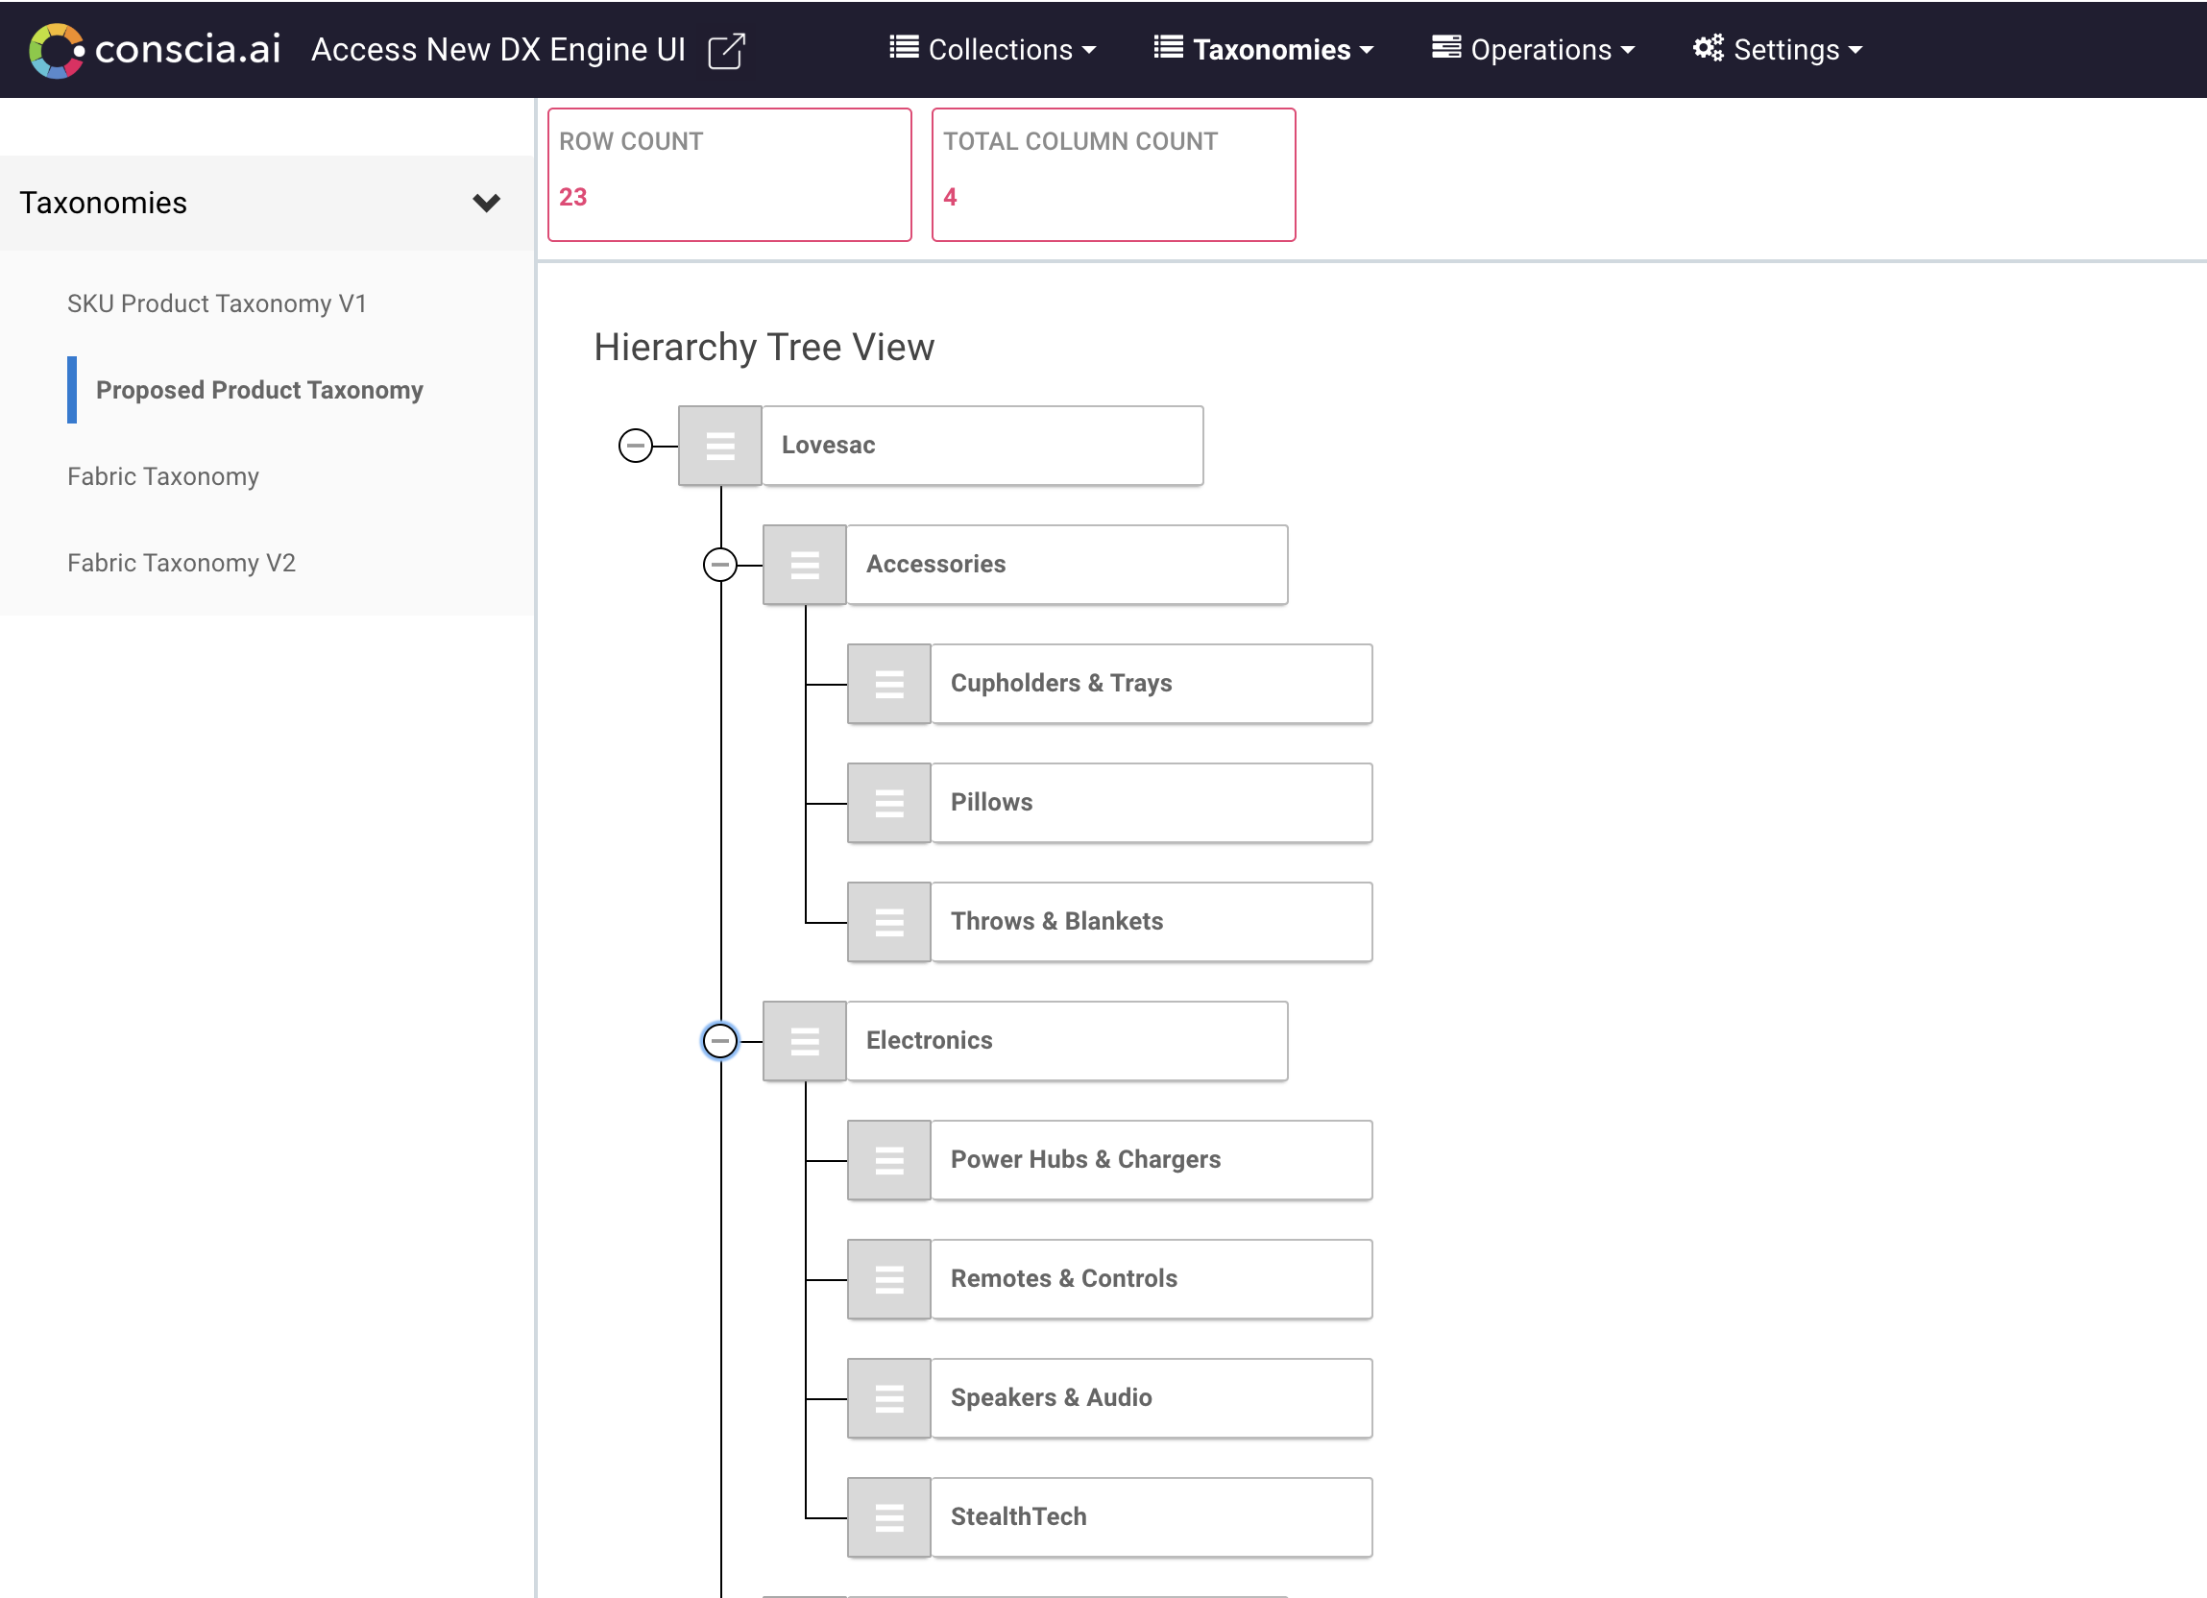
05 · DATA MODEL DEEP-DIVE
Collections, Hierarchies, Taxonomies
Demo of compatibility rules and data model in a sample hierarchy using Lovesac’s data and Conscia’s tooling — Part 2: Live in Conscia
GRAPH
DX Graph — Product Model
DEMO
· SKU Collection: ~13,700 records ingested from NetSuite
· Matrix items exploded into individual variant nodes
· Each node carries colour, cover, configuration attributes
· Relationships typed: COMPATIBLE_WITH, BUNDLES, CONTAINS
Lovesac × Conscia · Project Kick-off · April 8, 2026
Notes:
Laurel

Slide 11
06 · EARLY FINDINGS
Early Findings from Your Data
CATALOG STRUCTURE
~13,700
Compatibility is encodable from two fields
Across all ~11,500 Cover SKUs, Cover ↔ Insert compatibility resolves from Product == Product AND Sactional_Size == Sactional_Size. A single Dynamic Relationship in DX Graph replaces tens of thousands of manual mappings — and new SKUs are covered automatically.
Active SKUs analysed
across the full Lovesac catalogue
BREAKDOWN
~10,800 Sactional Covers
Covers · Inserts · other Sactional
~1,700 Sac & Snugg
~1,200 Accessories & spare parts
Across 3 brands: Sactional · Sac · Snugg
DATA QUALITY
Inconsistent attribute naming across product families
Color, fabric, and dimension fields use different naming conventions across Sactional, Sac, and Snugg. Recommend a normalisation pass during ingest to establish canonical attribute keys. Also observed: ~18 attribute fields per SKU; multiple legacy naming conventions; some product-line ambiguity (e.g. Squattoman: Sac or Ottoman?).
INTEGRATION READINESS
The big question is data access, not data shape
The product catalogue models cleanly. The open question is how data reaches Conscia from each source backend — API pull, file export via Celigo, or direct database. Confirming this for each of the 3 source systems is the first dependency on the timeline.
Lovesac × Conscia · Project Kick-off · April 8, 2026
Notes:
Laurel

Slide 12
07 · SCOPE & TIMELINE
Project Scope — Phase 1
DX GRAPH
in scope
DX ENGINE POC
in scope
OUT OF SCOPE — PHASE 1
not in Phase 1
DX Graph application provisioning and environment setup
SKU Collection — all ~13,700 SKUs (Sactional, Sac, Snugg, Accessories) in one unified collection
Configuration Collection for saved configs
Up to 3 Taxonomy Collections
Relationships: COMPATIBLE_WITH (Dynamic), BUNDLES (1:M), CONTAINS (1:M), MAPS_TO (1:M)
Data ingest from up to 3 source backends via Jobs (via Celigo — recommended, see appendix)
Config Validation orchestration flow
Visual Configurator wizard step options flow
Config ID Creation flow (with API write-back to DX Graph)
Config ID → BOM Explosion flow (POS / OMS / warehouse output shapes)
Experience Rules for series, Outdoor restrictions, and channel-specific constraints
Lovesac.com frontend integration (handled by Lovesac team)
Real-time inventory availability (depends on Q4 — Quickship resolution)
Production deployment to AgentForce / ChatGPT / Google Shopping (POC only)
Pricing engine integration (NetSuite continues as pricing master)
Manhattan Active Omni / OMS integration (downstream of BOM explosion)
PLM integration (TBD — depends on Q2)
✓ IN SCOPE
✓ IN SCOPE
✕ OUT OF SCOPE
Lovesac × Conscia · Project Kick-off · April 8, 2026

Slide 13
07 · SCOPE & TIMELINE
Implementation Timeline
PHASE 1
Weeks 1–3
TBD
Foundation & Data
Provision DX Graph environment
Model SKU Collection (single collection, all ~13,700 SKUs)
Model Configuration Collection
Build Cover↔Insert COMPATIBLE_WITH Dynamic Relationship
PHASE 2
Weeks 4–6
TBD
Taxonomy & Ingest
Model up to 3 Taxonomy Collections
Map all SKUs via MAPS_TO
Configure ingest Jobs from 3 source backends (via Celigo where applicable)
Validate data completeness and AI-derived compatibility rules with Lovesac team
PHASE 3
Weeks 7–10
TBD
DX Engine POC
Build Config Validation orchestration flow
Build Wizard Step Options flow
Build Config ID Creation flow (with DX Graph API write-back)
Build BOM Explosion flow (POS / OMS / warehouse output shapes)
PHASE 4
Weeks 11–12
TBD
Testing & Handoff
End-to-end integration testing across all flows
Channel QA (POS via Salesforce Retail Cloud, Lovesac.com sandbox)
Documentation and runbooks
Knowledge transfer to Lovesac team
⚠ Phase 1 dependency
⚠ Phase 2 dependency
⚠ Phase 3 dependency
✓ Phase 4 — clear to proceed
Source backend confirmation (Q1)
Hierarchy decision (Q3) + adjacency rules (Q5)
Quickship resolution (Q4) + PLM alignment (Q2)
No blocking dependencies
Contingent on Phases 1–3 completing on schedule
Time estimates are indicative and will be confirmed once open questions are resolved per the dependency flags above.
Lovesac × Conscia · Project Kick-off · April 8, 2026

Slide 14
08 · SUCCESS METRICS & WAYS OF WORKING
Success Metrics & KPIs
Phase 1 Engagement Goals
Business Outcomes
How We'll Measure
All ~13,700 SKUs ingested into a single DX Graph SKU Collection
COMPATIBLE_WITH Dynamic Relationship live across all ~10,800 Cover SKUs
Up to 3 Taxonomy Collections modelled and mapped via MAPS_TO
All four DX Engine flows (Config Validation, Wizard Step Options, Config ID Creation, BOM Explosion) running end-to-end against Lovesac data
Single source of truth for Sactional compatibility
POS associates can validate any configuration in real time
New channels (kiosk, agent, feed) reuse the same Experience API instead of rebuilding logic
Foundation in place for AgentForce / ChatGPT / Google Shopping integration
API response time: < 200ms p95 for configurator queries
Zero data sync failures over a 30-day observation window
All four DX Engine flows pass end-to-end UAT against Lovesac test cases
Lovesac sign-off at each phase gate (4 gates over 12 weeks)
Latency and volume targets to be confirmed with Lovesac at first technical review.
Lovesac × Conscia · Project Kick-off · April 8, 2026

Slide 15
08 · SUCCESS METRICS & WAYS OF WORKING
Ways of Working
TEAM STRUCTURE
WORKING CADENCE
Weekly Project Standup
30 min · Both teams · Status, blockers, decisions
Role | Conscia | Lovesac
Executive Sponsor | Sana | Amelia Jacobs
Project Lead | Morgan | TBC at kickoff
Solution Architect | David | Tate Swanson
Solution Engineer | Laurel | Data owner — TBC
Platform Engineer | Harshil | Tech lead — TBC
QA / Testing | Laurel & Harshil | TBC
Bi-weekly Steering Check-in
60 min · Leads only · Scope, risks, milestones
As-needed Technical Review
Data model, API design, integration reviews
End of Phase Phase Gate Review
Demo, sign-off, and next phase kick-off
Ongoing Slack / async comms
Shared channel for day-to-day coordination
Lovesac × Conscia · Project Kick-off · April 8, 2026

Slide 16
09 · OPEN QUESTIONS & NEXT STEPS
Open Questions
We've shared a full questions document with your team ahead of today (32 questions across 5 areas). This slide is the shape of that conversation — we'll go deeper on the items most likely to shape Phase 1.
12 Qs
DATA
6 Qs
INTEGRATION
9 Qs
CONFIG & RULES
· Where did each product file come from, and which is authoritative?
· Will product data flow via Celigo, or directly from source?
· PLM (TBD) vs DX Graph — who is the product master?
· How does a validated config reach Manhattan Active Omni today?
· Quickship — product type or live inventory?
· Adjacency rules — please validate our proposed table.
3 Qs
USER STORIES
2 Qs
PROJECT & GOVERNANCE
· What does the in-store POS configuration workflow look like today?
· Are there planned changes to the lovesac.com configurator UX?
· Who is the named Lovesac PM?
· What are the POS volume and latency expectations?
Full document: Questions_for_Lovesac_EXT_Conscia.docx — sent April 2
Lovesac × Conscia · Project Kick-off · April 8, 2026

Slide 17
09 · OPEN QUESTIONS & NEXT STEPS
Next Steps
Actions coming out of today's session — owners and target dates for both teams.
April 9
Both
Distribute kickoff notes, decisions log, and open-question owners
April 11
Lovesac
Confirm the 3 source backends — name, access method (API / file via Celigo / direct), refresh cadence
April 11
Lovesac
Confirm which of the 3 hierarchy proposals from the March 12 review will be adopted
April 14
Lovesac
Validate the proposed component adjacency table (resolves Q5)
April 9
Lovesac
Name the Lovesac Project Manager and Data Owner
April 11
Conscia
Provision DX Graph sandbox environment and share credentials
April 9
Conscia
Share the AI-derived compatibility rules document for product-team review
April 15
Both
First weekly project standup — review readiness, lock Phase 1 sprint plan
Lovesac × Conscia · Project Kick-off · April 8, 2026

Slide 18
APPENDIX
APPENDIX
Reference material — Threekit & Conscia comparison and phased role transition.
Lovesac × Conscia · Project Kick-off · April 8, 2026

Slide 19
Threekit & Conscia: Different Jobs, Different Tools
APPENDIX
Dimension
Threekit
Conscia
Primary job
3D product visualisation & configuration
API-layer orchestration across all systems
Data stored
Visual assets, component rules, constraints
Product graph, business logic, channel rules
Who queries it
Lovesac.com configurator only
Any channel — web, app, kiosk, AI agent
How data flows
Push: Lovesac team uploads updates manually
Pull: real-time API calls, live sync
AI / agent access
Not designed for programmatic access
Native MCP endpoint; agent-ready by design
Where it lives
SaaS, Threekit-hosted
Orchestration layer above your existing stack
Phase 1 role
Continues as the rendering engine
Reads from Threekit, exposes data everywhere
Lovesac × Conscia · Project Kick-off · April 8, 2026
Notes:
SPEAKER NOTES — Threekit & Conscia: Different Jobs, Different Tools
The goal is to reframe the conversation: Threekit is not being replaced — it is being enhanced. Conscia sits above it and reads from it.
Key points:
• Threekit was built to solve a hard visual problem. The constraint is a scoping decision, not a product flaw — Threekit is a renderer, not an integration layer.
• Conscia is the integration layer. The two products are designed for different layers of the stack and are genuinely complementary.
• Phase 1 preserves Threekit as the configurator. Conscia ingests from it — it does not replace it.
• Adding Conscia reduces integration burden: every new channel uses the same Experience API rather than building a new Threekit connector.
Do not use the word 'limitation' or 'weakness' when referring to Threekit. Frame all differences as design intent.

Slide 20
Celigo and Conscia: Complementary Layers
APPENDIX
Different categories of tool solving different problems in the Lovesac stack
Concern
Celigo (iPaaS)
Conscia (DX Graph + DX Engine)
Category
Integration Platform as a Service
Governed semantic layer + experience orchestration
Core job
Move records between SaaS apps with mapping and error handling
Hold the canonical product model and serve real-time channel APIs
Data pattern
Batch and event-driven flows, source-to-destination
Unified graph with relationships (COMPATIBLE_WITH, BUNDLES, CONTAINS)
Latency
Throughput-optimised: scheduled or webhook
Sub-second synchronous, on the critical path of POS and web
Rules
Flow-level branching for integration builders
Business-user Experience Rules: priority, A/B, segmentation
Frontend
None — frontends call multiple flows or build their own BFF
Single Experience API call returns unified, channel-shaped JSON
Agentic / MCP
MCP server exposes integration flows
MCP server exposes governed semantic capabilities
Where it shines
NetSuite ↔ Adobe Commerce ↔ Manhattan Active Omni ↔ Salesforce plumbing
Config validation, BOM explosion, wizard steps, agentic channels
The Sactional SKU-explosion problem is a model and orchestration problem, not a transport problem.
Celigo moves data between systems. Conscia gives that data meaning and serves it in real time.
Lovesac × Conscia · Project Kick-off · April 8, 2026
Notes:
Lovesac is already a Celigo customer — Kimberly Dietz is publicly quoted endorsing the NetSuite-Magento Integration App. We are not displacing any Celigo flow.
Celigo is genuinely good at what it does: moving customer records, orders, inventory, fulfilments, and item master data between NetSuite, Magento, Manhattan Active Omni, and Salesforce Retail Cloud.
What Celigo cannot do — by category, not by quality — is hold a governed semantic model of what a Sactional is, encode component compatibility as queryable graph relationships, or serve a synchronous sub-second Experience API to a POS terminal during checkout.
Those are different categories of problem and they need different categories of tool. The kickoff narrative is additive, not substitutive.

Slide 21
How Conscia Integrates with Celigo
APPENDIX
Three patterns, one end-state architecture
A. INGEST
RECOMMENDED
B. READ PATH
C. BOM HANDOFF
POS calls Conscia direct, Lovesac.com calls Experience API & Agent shopping calls via MCP
Celigo feeds Conscia
Conscia hands off via Celigo
Celigo's existing NetSuite item/matrix/kit exports also write to Conscia ingest endpoint
Reuses existing saved searches, custom fields, and field mappings
JSON webhook or SFTP — nightly delta + on-demand full refresh
Why: don't rebuild work Celigo is already doing well
Salesforce Retail Cloud calls DX Engine Experience API directly for real-time config validation
Celigo is not on this path — wrong latency profile for synchronous checkout
Phase 1 POC scope
DX Engine produces exploded BOM from a Config ID
Hands off to existing Celigo flow talking to Manhattan Active Omni
Conscia = config brain; Celigo = logistics plumbing
Data flow diagram
Magento / Adobe Commerce
NetSuite
ERP / Product Master
Celigo
iPaaS
Salesforce Retail Cloud
Manhattan Active Omni
(A) ingest feed → DX Graph
(C) BOM handoff
POS Terminals
(B) real-time validation
DX Graph
Governed Product Master
DX Engine
Real-Time Orchestration
Lovesac.com
(B) Experience API
Google Shopping / ChatGPT
(B) via MCP
Lovesac × Conscia · Project Kick-off · April 8, 2026
Notes:
Pattern A is the strong default for ingest. Lovesac has already paid for Celigo's NetSuite expertise — the saved searches, the matrix item handling, the eTail configuration on item records, the custom field mappings. Re-implementing all of that in DX Graph Jobs against raw NetSuite is duplicative and slow. We piggyback on the work Celigo is already doing.
Pattern B is the real-time read path: POS hits Conscia directly because synchronous sub-second validation is exactly the latency profile iPaaS isn't built for.
Pattern C is the downstream hand-off — DX Engine does the configuration brain work, but the consumer (Manhattan Active Omni) is reached via an existing Celigo flow rather than building a new direct connection.
The one genuine overlap to clarify at kickoff is the marketplace feeds: the kickoff deck commits Conscia to updating two existing feeds, and if those are currently produced by Celigo flows we need to agree whether ownership transfers or whether Conscia provides the data and Celigo continues to ship it.

